Slide 1



presented by-
Mahima Nema
NETFLIX MOVIE
DATA ANALYSIS

Slide 2



Netflix Movie Data Story
Netflix Movie Data Story
Introduction
"Imagine you're browsing Netflix — so many titles, so many genres — but what kind of movies really dominate the platform? What do audiences love the most? And what are the trends behind Netflix’s massive movie library? That’s what I wanted to uncover in this project."

Slide 3

Netflix Movie Data Story
Our Dataset — What We’re Working
"I worked with a dataset containing 9827 movie records with details like title, release date, genre, popularity, vote average, and vote count.
It was clean — no missing or duplicate values — but it needed some organizing before diving into insights."

Slide 4
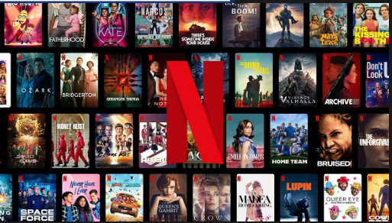
Netflix Movie Data Story
Cleaning & Preprocessing — Shaping the Data
To turn raw data into usable information, I performed several cleaning steps:"
Converted the release date into just the year so we could track trends over time.
Dropped unnecessary columns like overview, original language, and poster URLs — these didn’t help in our analysis.
Categorized vote averages into four groups: Not Popular, Below Average, Average, and Popular, so we could analyze audience preferences better.
Split multiple genres into individual rows to handle movies with more than one genre — this gave a clearer picture when counting genres.
"This step was crucial — transforming data makes analysis meaningful."

Slide 5
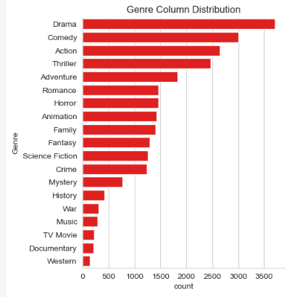
Netflix Movie Data Story
Question 2
Genres — What Dominates Netflix?
Genres — What Dominates Netflix?
"After splitting the genres, I asked — what’s the most common genre on Netflix? The answer was clear — Drama leads by a significant margin. "This shows how Netflix’s library leans heavily toward emotional, narrative-driven films."
What is the most frequent genre of movies released on Netflix?

Slide 6
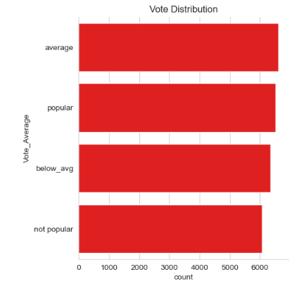
Netflix Movie Data Story
Question 1
"Next, I explored how audiences rate these movies. By categorizing the average votes, we saw that most movies are rated as ['Average']." "This suggests that while Netflix has a huge variety, many movies receive moderate ratings."
Which has highest votes in vote avg column?

Slide 7

Netflix Movie Data Story
Question 3
"Popularity can tell a different story than ratings.
So — what’s the most popular movie on Netflix?"
🎥 Spider-Man: No Way Home
Genres: Action, Adventure, Science Fiction
Popularity Score: 5083.954
"At the other end of the spectrum, the least popular titles included:"
The United States vs. Billie Holiday (Music, Drama, History)
Threads (War, Drama, Science Fiction)
"It’s interesting how a blockbuster superhero movie dominates while niche films stay under the radar."
highest popularity and lowest popularity

Slide 8
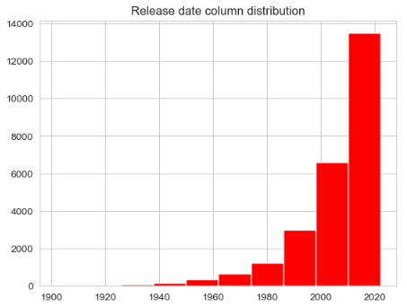
Netflix Movie Data Story
Question 4
"I wanted to see which year Netflix released the most movies. After breaking down the release years, 2020 stood out with the highest number of releases." "This might reflect Netflix’s aggressive expansion in content production."
Which year has the most filmmed movies?

Slide 9
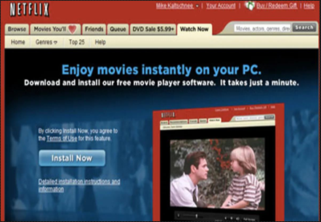
Netflix Movie Data Story
Key Takeaways — What We Learned
Drama is the most frequent genre on Netflix.
Most movies fall into the Average rating.
Spider-Man: No Way Home was the most popular movie in the dataset.
2020 had the highest number of movie releases.
"These insights can guide decisions in content curation, marketing focus, and audience targeting."

Slide 10

Netflix Movie Data Story
Final Thoughts
"This project demonstrated how simple data, when cleaned and visualized correctly, can tell powerful stories about audience preferences and content trends on a major platform like Netflix."
"It’s not just numbers — it’s about understanding what people watch, love, and respond to."

Slide 11

Thank You!!

